Slide 1
What is a Games Based approach to training?
A Games Based approach to coaching ensures that players are exposed to different types of games to develop techniques and skills in an appropriate environment.
While traditional drills (linear) provide an organised structure for gradual developing technique, fun games and modified games provide an opportunity to practice skills of the game in an open environment where decisions - such as where to move, whether to take possession, which skill to preform - are forced upon players.

Slide 2
The key outcomes from a Games Based approach to coaching are:
Increased exposure to game like situations.
Increased self awareness of ability level.
Increased opportunity to make decisions.
Increased sense of responsibility for players.

Slide 3
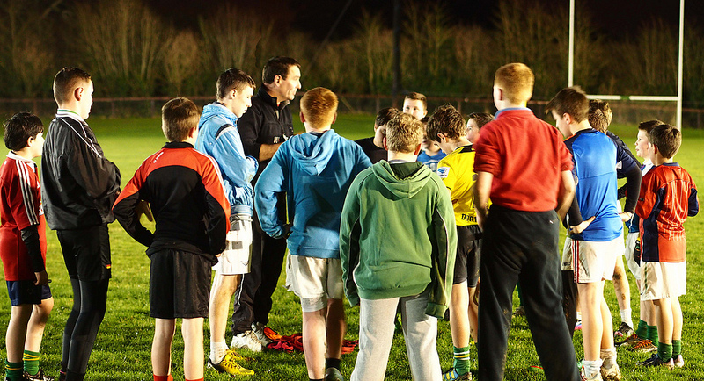
What is a mixed ability and what types can a coach have on his/her panel?
Mixed ability refers to any person who has a different or mixed physical ability. It can also refer to anyone who has a different emotional or learning ability.
Skill level
Age or maturity
Intelligence
Motivation/attitude towards training
Player reliance/autonomy
Learning style

Slide 4
Possible problems which may arise when coaching a mixed ability team.
Identifying levels of mixed abilities
Various standards
Individual player strengths and weaknesses
Different levels of interest and motivation
Balancing time evenly
Not enough time to focus on weaker/stronger players
Achieving effective coaching for all
Too easy/too difficult
Participation
Discipline/focus
Communication
Do they understand what you are saying?

Slide 5
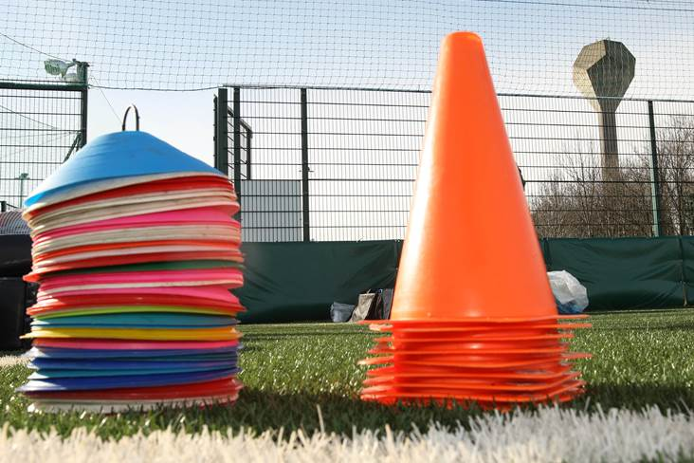
How do we cater for these mixed abilities in a Games Based approach to training?
Assess the players
Become aware of the individuals
Plan effective sessions
Introduce proper communication

Slide 6
Support play/breaking tackle drill
Using a rectangular grid 3 v3 line up in the middle. Each team has a last man back(LMB) that protects the end line.
The ball starts on the ground where players must battle to rise it.
The team that wins possession must handpass the ball to each other working the ball past the opposition LMB over the line.
When a score is achieved the LMB is changed and play begins with the ball starting again in the middle.
Progressions:
When the team wins the ball off the opposition, they must work the ball back to their LMB first before beginning their attack back towards the opposition line.
Players are allowed strike pass to each other or back to their keeper.
Add players to increase intensity.

